Slide 1
Session 3
Modified Condition/Decision Coverage (MC/DC)
苏州大学计算机科学与技术学院 程宝雷

Slide 2
  Complete Coverage
  Path Coverage
∪
  Condition Combination Coverage
  Modified Condition-Decision Coverage
  Condition-Decision Coverage
  Condition Coverage
∪
  Decision Coverage
  Statement Coverage

Slide 3
Modified Condition/Decision Coverage (MC/DC)
A code coverage criterion that requires:
  Each entry and exit point is invoked
  Each decision takes every possible outcome
  Each condition in a decision takes every possible outcome
  Each condition in a decision is shown to independently affect the outcome of the decision.

Slide 4
MC/DC
Independence of a condition is shown by proving that only one condition changes at a time.
MC/DC is used in avionics software development guidance DO-178B and DO-178C to ensure adequate testing of the most critical (Level A) software.

Slide 5
MC/DC

Slide 6
int function1（bool a，bool b，bool c）
{
int x=0;
if(a&&(b||c))
x=1;
return x;
}

Slide 7
Exercise
Decision coverage
Condition coverage
Condition combination coverage

Slide 8
MC/DC
序号 | a | b | c | a&&(b||c)
1 | T | T | T | T
2 | T | T | F | T
3 | T | F | T | T
4 | T | F | F | F
5 | F | T | T | F
6 | F | T | F | F
7 | F | F | T | F
8 | F | F | F | F
a | b | c
5
6 | 4
7 |  | 4
 | 2 | 3
1
2
3
n+1~2^{n}
{1, 2, 3, 4, 5} / {2, 3, 4, 6}

Slide 9
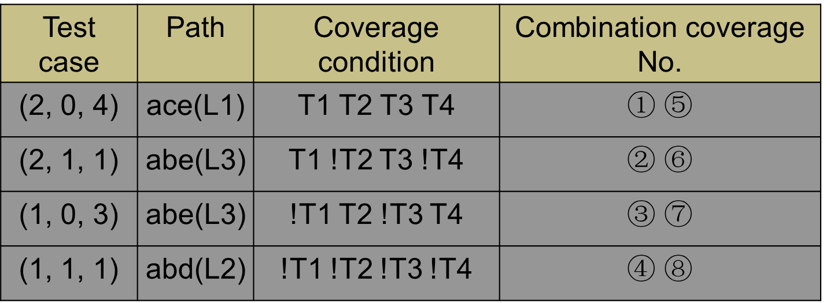
a
b
F
T
c
(A>1) ∧(B=0)
x=x/A
Path：
L1(a→c →e)
L2(a→b →d)
L3(a→b →e)
L4(a→c →d)
Design test cases to satisfy MC/DC of this example.
d
F
T
e
(A=2) ∨(x>1)
x=x+1

Slide 10
MC/DC
The MC/DC criterion is much stronger than the condition/decision coverage.
The MC/DC criterion is NOT stronger than Condition Combination Coverage.
Update Exercise 5/6

Slide 11
Exercise 5’
Design test cases for the following flowchart to satisfy 8 types of coverage。(Note: X and Y are signed integers or 0)
N
X>8 AND Y>5
Y
X>0 OR Y>0
X>16 OR Y>10
N
Y
N
Y
S3
S1
S2

Slide 12
Exercise 6’
Try to analyze the relationship among 8 different coverage strategies
  Statement Coverage
  Decision Coverage
  Condition Coverage
  Condition-Decision Coverage
  Condition Combination Coverage
  Path Coverage
  Complete Coverage
  Modified Condition/Decision Coverage

